Slide 1



Finance Dashboard By Kamal Kumar
View in Power BI
Last data refresh:
8/29/2021 3:28:02 AM UTC
Downloaded at:
1/17/2022 12:11:38 PM UTC

Slide 2
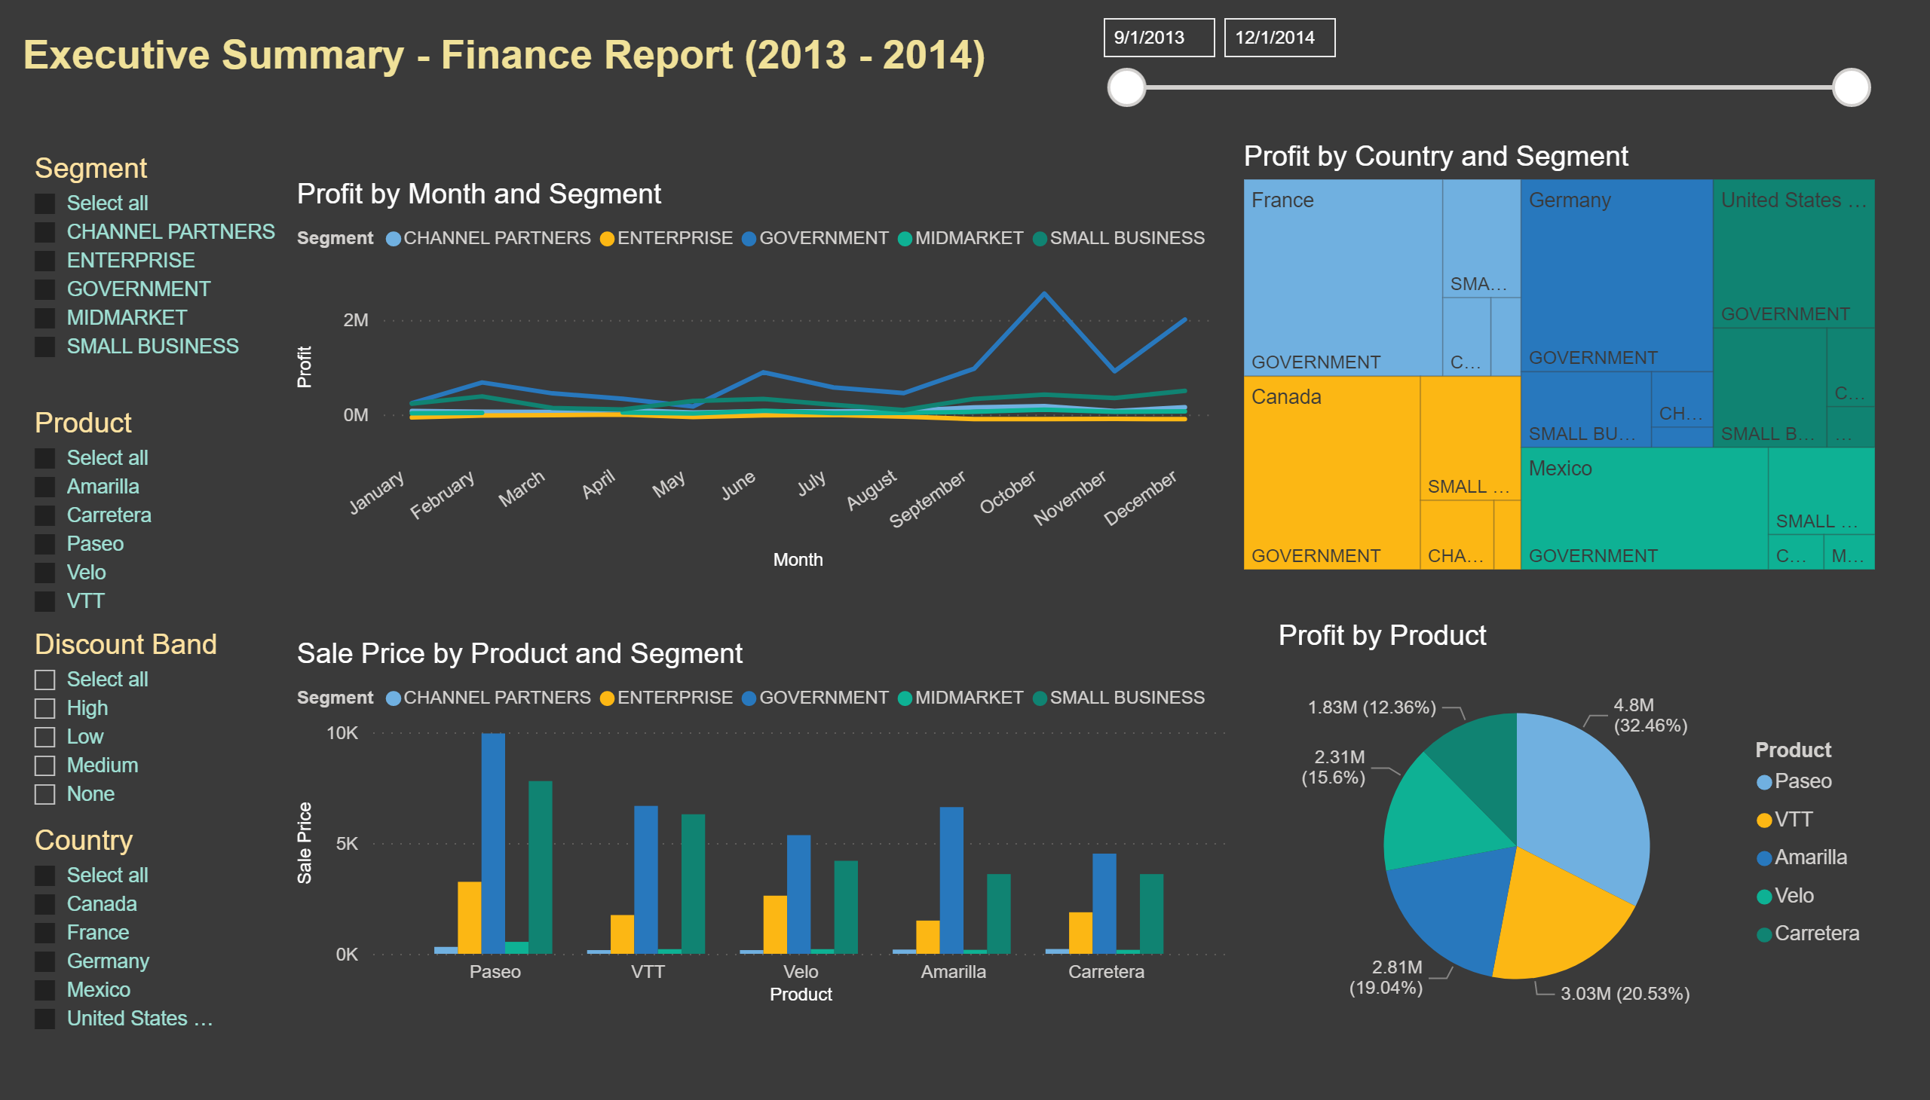
Page 1
Notes:
textbox
No alt text provided
lineChart
No alt text provided
clusteredColumnChart
No alt text provided
slicer
No alt text provided
pieChart
No alt text provided
treemap
No alt text provided
slicer
No alt text provided
slicer
No alt text provided
slicer
No alt text provided
slicer
No alt text provided

